Slide 1
Amp'ed RF Technology, Inc.
August 6, 2016

Slide 2
Company Overview
Highlights
Founded in 2003 in Silicon Valley San Jose CA
Wireless connectivity provider: WiFi and Bluetooth
Office opening in Tianjin, China 2009
Audio/Video Bluetooth SIG Working Group Member
San Jose, CA
R&D and sales support
Tianjin, China
R&D, sales support and manufacturing

Slide 3
WiFi Connectivity
ACC1340
Amp’ed RF Connectivity Controller
Features
Dual Band 2.4/5GHz
802.11a/b/g/n
802.11d Regulatory Domain
802.11h 5GHz TPC/DFS
802.11r
21dBm 2.4GHz PA integrated
-97dB Rx sensitivity
Wi-Fi Direct
Soft Access Point
Wi-Fi and Soft AP Concurrent operation
Hotspot 2.0
Benefits
Single chip radio solution
Dual Band 2.4 GHz and 5 GHz support
Best in class RF performance
73-pin WLCSP package
Low external component count
Now Available

Slide 4
Audio Host MCU
ACH1180
Audio Connectivity Host
Analog and I2S audio output
Differential mic input
Floating point processing
Integrated AES encryption engine
Benefits
SoC Host solution: MCU+DSP+CODEC
Supporting CD quality stereo CODEC
Integrated clock management
Cortex M4F, 200MHz
Low power consumption
ACH1180
RF
RF Radio
ACC1340
Serial
I2S/SPI
832K RAM
UART
Clock
GPIO
Audio In/Out
Sampling – Q1 2017

Slide 5
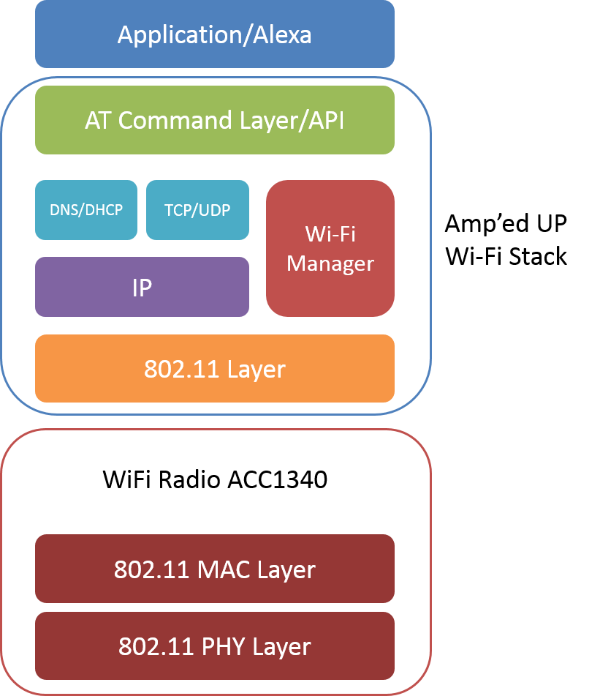
Embedded Software
WiFi Protocol Stack
Upper layer stack
Embedded RTOS (non-Linux)
Small memory footprint
Optimized for audio applications
OTA – over-the-air software updates
Audio Processing Software
Echo and noise cancellation
Voice filtering and detection
Audio compression
Adaptive playback
Secure audio data AES encryption

Slide 6
Bluetooth Module
RF
Filter
CC2564
Host Controller Interface
ARM Cortex MCU
Including Amp’edUP Stack
BT Radio Chipset
TI CC2564
Host μController
ARM Cortex M4
Bluetooth Protocol Stack
Amp’edUP Bluetooth Stack
Flash
64K/128K/256K
UART
SPI
I2C
RAM
8K/16K/48K
GPIO
Clock
I2S

Slide 7
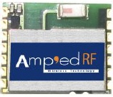
Bluetooth Modules
Bluetooth Dual-mode BT53
Bluetooth SIG Declaration ID: D025845
Bluetooth SIG Qualified Design ID: 65782
Features | BT53
Specification | Bluetooth v4.1
RF chip | TI CC2564
Power class | Class 1
Range | 60m LOS
Dimension | 11.6 x 13.5 x 2.2 mm
Data rate | 500K bps over IAP 1.2M bps over SPP
Interfaces | UART, SPI, I2C, I2S
13.5mm
11.6mm
BT53

Slide 8
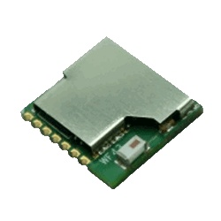
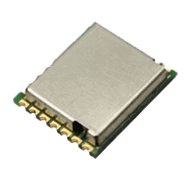
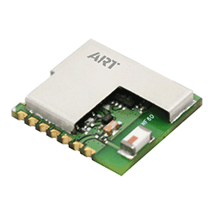
WiFi Modules
WiFi Dual-band WF43/WF52/WF60
WF43
Features
Specification | 802.11 a/b/g/n
RF chip | ACC1340
Frequency | 2.4GHz/5GHz
Range | 100m LOS
Dimension | 14.6 x 13.5 x 2.2 mm
Data rate | >2Mbps TCP/UDP
Interfaces | UART, SPI
WF52
WF60

Slide 9
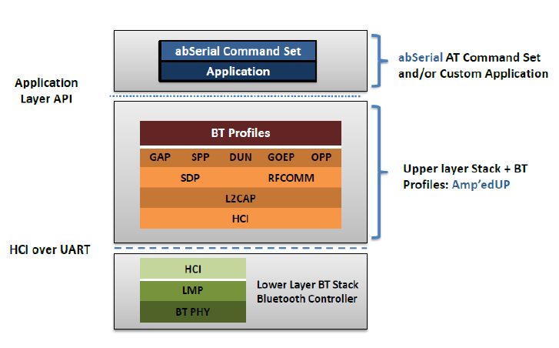
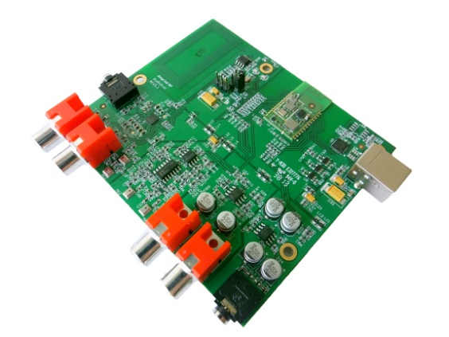
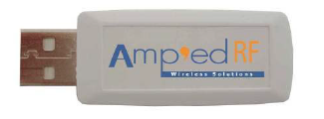
Product – Development Tools
Data EVB: BT253 Audio EVB SW: Amp’edUP SDK
Classic Bluetooth Stack
Data Features
Supported Bluetooth v4.1 with SPP, iAP 1/2 and other optional profiles.
Audio Features
Supported Bluetooth v4.1 with A2DP, AVRCP, HFP and other optional profiles
Amp’edUP Software Developing Tool
Supported end-user customization of our modules through the use of Amp’edUP SDK

Slide 10
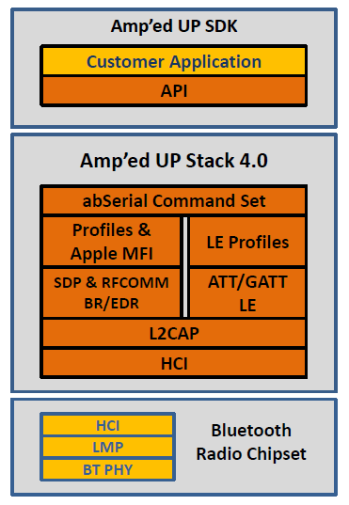
Bluetooth Stack
Amp’edUP Bluetooth Stack
Both Classic and Low Energy Options Combined
Support
Apple MFI
Amp’ed UP SDK
High Quality Audio
End-User Customization
Features
Classic Profile：SPP, IAP, A2DP, HFP, AVRCP, HID
BLE：ATT, GATT，Prox，Findme，HID，OBEX， Indoor Positioning
Amp’edUP 4.0 Combo

Slide 11
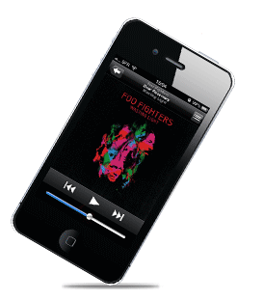
SonicART
Spkr/
Headset
Analog
Codec
Sonic ART is our proprietary Bluetooth audio enhancement software suite.
Analog
I2S
Mic
Analog
BT Module
Features
A2DP/HFP profiles supported
FLECS, Frequency Lock and Error Concealment Sampling
Sampling rates up to 48KHz, Data rates up to 512K bps
Acoustic Echo Cancellation and Noise Reduction
Low Latency Options, <25ms
Wide Band Speech

Slide 12
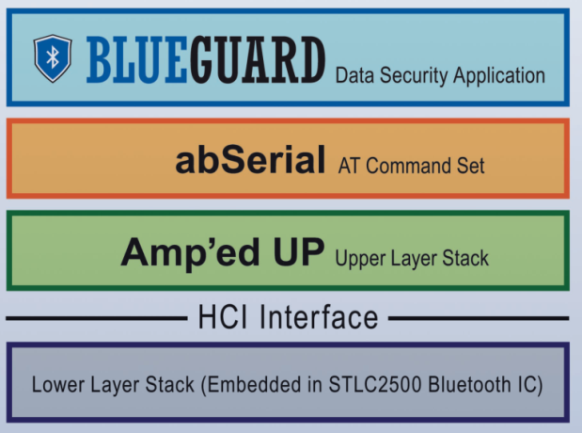
BlueGuard
BlueGuard
BlueGuard is an embedded firmware application layer which runs on top of our exiting Bluetooth Stack & profiles.
Features
Strong Data Security for Payment Card Industries Systems
MIPS FIPs 140-2, Level 3 Data Security Standards
Eliminates Standard Bluetooth Security gaps
Triple DES Data Encryption
Protect Data over public networks!

Slide 13
Business Model
Technical Support
Stage | Support Available
Wireless system design | Customized support from Amp’ed RF’s engineers.
Hardware design | Reference designs, schematics and layouts, for proven WiFi and Bluetooth modules currently in production.
Firmware integration | Available technical guides: API interface, Generic Kernel/OS interface, Target abstraction layer interface. Working example code is provided.
Regulatory certification | Leverage our partnership with TUV labs for low cost and quick certifications.
Mobile device app development | Example source code available for Android and iOS.
Production | High speed production test software available.

